Slide 1
Making of the Modern Mind

Slide 2
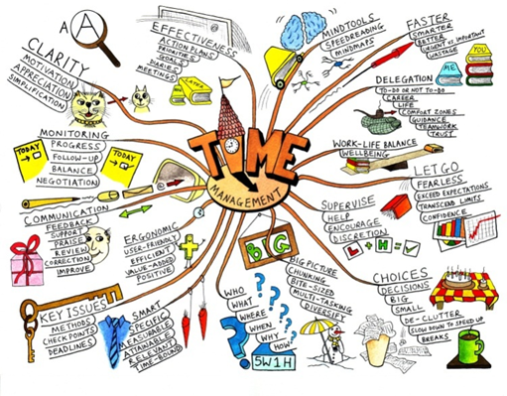
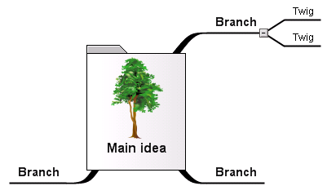
This course integrates:
Philosophy of Mind
Humanities
Cognitive Science/Psychology
Critical Thinking
A way to stimulate your mind
Opens a flow of creative thinking
A way to see how things connect
Whole braining thinking that identifies and solves problems
Brainstorm
Visualize
Think in a new way

Slide 3
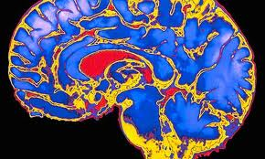
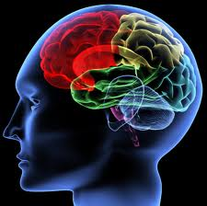
“You have been entrusted with the care and feeding of the most extraordinary and complex creation in the universe.
Home to your mind and personality, your brain houses your cherished memories and future hopes.
It orchestrates the symphony of consciousness that gives you purpose and passion, motion and emotion.”
But what do you really know about it ?
(Quote from Franklin Institute for Science Learning)
Notes:
http://www.quantumconsciousness.org/presentations/whatisconsciousness.html

Slide 4
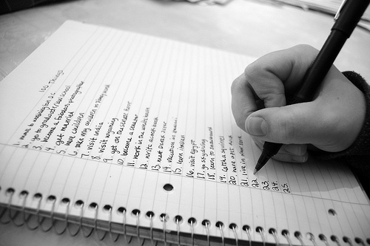
Make a list:
How many uses can you think of for a chair?

Slide 5
individuation
http://psychology.about.com/od/sensationandperception/ig/Optical-Illusions/spinning-dancer-illusion.htm
http://www.heraldsun.com.au/news/right-brain-v-left-brain/story-e6frf7jo-1111114603615

Slide 6
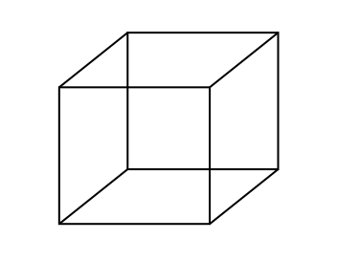
Bistable Perception /Multistable Perception
Rubin face-vase illusion
Necker Cube
Both images are bistable perceptions, in which the brain spontaneously
switches between two interpretations of the same ambiguous stimulus

Slide 7
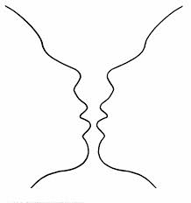
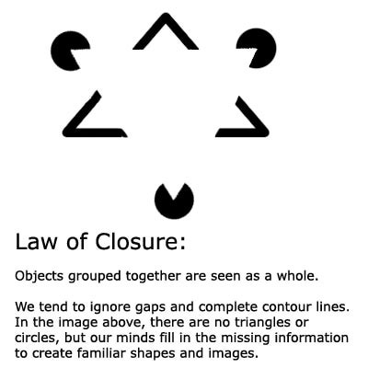
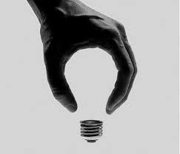
Gestalt Laws of Perceptual Organization
Our brains ignore contradictory information and fill gaps in with information.
Confabulation: (Psychology ) To fill gaps in one's memory with fabrications that you believes to be facts.

Slide 8
THE MISSING HORIZON Individual Perception & perspective

Slide 9
POP-PSYCHOLOGY and myths
We only use 10% of our brain
That we’re left brain or right brain thinkers

Slide 10
Priming …And the cognitive dissonance that follows…
How did the article prime us to see her spin one way or the other?
Notes:
In two weeks we’ll talk about priming- and how you can prime someone.
What Cognitive dissonance is, including Milgram Experiment, and the discomfort of the ‘teachers” as an example

Slide 11
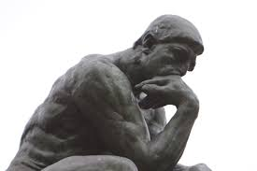
The left hand doesn’t know what the right hand is doing?
Decides there is a final stage that pulls information together
Wins a Nobel Prize 1981
Note that the theory of Left Brain Narrative is similar to Confabulation
http://www.medclip.com/index.php?page=videos&section=view&vid_id=103271

Slide 12
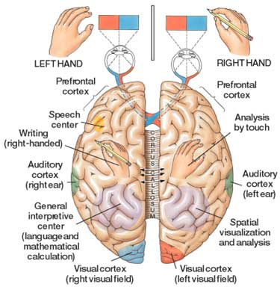

Slide 13
The Split-Brain (Gazzaniga & Sperry at Cal-Tech)
Wins a Nobel Prize 1981
https://www.youtube.com/watch?v=lfGwsAdS9Dc
https://www.youtube.com/watch?v=ZMLzP1VCANo

Slide 14
Split-Brains
Dr. Gazzaniga:
“The brain isn't like a computer, with specific sections of hardware charged with specific tasks. It's more like a network of computers connected by very big, busy broadband cables. The connectivity between active brain regions is turning out to be just as important, if not more so, than the operation of the distinct parts.”
Experiments have shown:
It was commonly believed that the left brain is analytic and the right brain is artistic but fMRIs shows that specialized tasks engage networks across the entire brain
That each half of the brain can function independently
That while each brain can act independently, with communication they can work together
That each half of the brain can compensate for the other half
Dr. Gazzaniga talks about the story we create:
https://www.youtube.com/watch?v=ZMLzP1VCANo

Slide 15
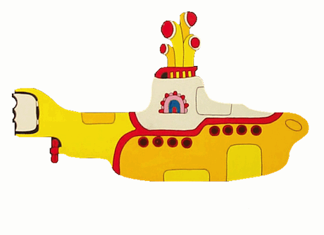
Dr. Michael S. Gazzaniga: Split brain research
Hmmm. Who’s driving the submarine?
https://www.youtube.com/watch?v=laRyswIO_-g

Slide 16
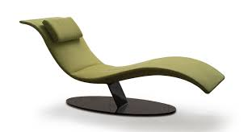
Critical Thinking Questions:
Remember the chair and how to use it?
How creative were you?
Do you think the test can assess creativity?
PRIMING: If I had included an image of a chair along with the question, do you think your answers would have changed? How? Why?
GROUP THEORY:
Were large groups more creative than the smaller groups- did you
think being in a group was good- / or were individuals more creative?
Did individuals feel marginalized, more pressure, or did you think there was there more freedom to think?
Did urge to be competitive- a me/us vs them kind of thinking?

Slide 17
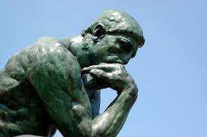
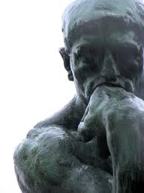
Q: Why Study Philosophy of the Mind?
A: The Brain is the Final Frontier
There is so much left to discover
and so much we don’t know
Notes:
MOVE THIS LATER- CONNECT TO MEMORY ACQUISITION…
REPLACE THIS HERE W/ TALK ON 1) DESCARTES SHIP 2) LEGAL DEFENSE 3) EDUCATION TABULA ROSA 4) GOVERNMENT, RIGHTS AND EQUALITY (ETHICS) 5) medicine- cures

Slide 18
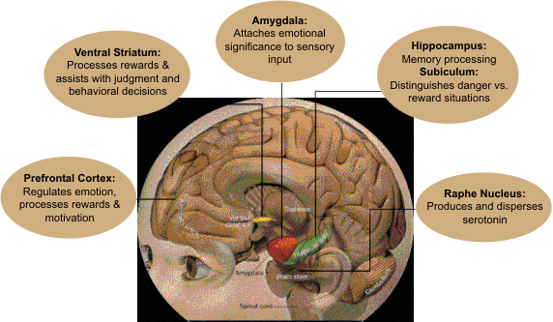
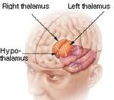
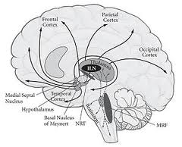
Q: What is Philosophy of Mind?
A: Generally it includes
study of the mind, mental events and functions
relation of the mind to the brain and the body
properties of the mind
consciousness
Notes:
A:
It generally includes study of the mind, mental events
and functions, properties of the mind, consciousness
and the relation of the mind to the brain and the body

Slide 19
Three Approaches | Three Perspectives:
1.) Relation of mind to brain and body
Is your mind something distinct from your body, or
do ordinary physiological processes produce minds?
2.) Applied Engineering
3.) The Universe and laws of physics

Slide 20
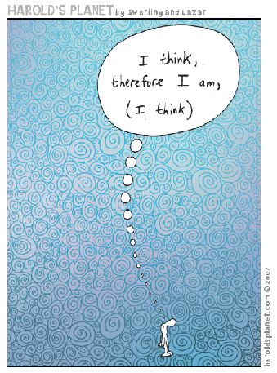
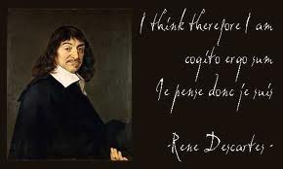
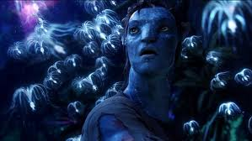
The mind-body problem
Q:
How does the mind relate to physicality- the brain & nervous system ?

Slide 21
Mind Body problem
Dualism:
holds that body and mind are separate substances
Property Dualism
1. Physical properties
Consciousness = neurobiology
2. Mental Properties
Material evolves properties depending on how its used or activated
Substance Dualism
1. Mind is material substance
2. Body is material, but it can’t think
Cartesian Dualism: argues that there is a two-way interaction between mental and physical substances
How can the mind, which is immaterial, cause anything?
How can something immaterial, react with material?

Slide 22
What is the Connection between Mind, Matter and Space? (the hard problem of consciousness)
The mind is affected by matter.
The mind can move matter in space.
The mind produces brain waves in space when thinking.
Can you think of examples?
What does mind over matter mean?
What does it mean when we say: Are you out of your mind?
Notes:
On the Connection between Mind, Matter and Space.
The Mind can Move Matter in Space. Walking around, eating, breathing, typing are all examples of this.
This is why we have evolved hands and feet, arms and legs - so our mind can move our body around. T
The motion of matter and mind in space are one connected thing - the wave motion of space.
The Mind is Affected by Drugs (Matter). Mind is affected by Food
It is well known that certain drugs, which are made of matter, can have profound effects upon the mind.
Again this clearly confirms the connection between mind and matter, that matter has a profound effect on the functioning of the mind.
The Mind Produces Brain Waves in Space when Thinking.
Again, this is well known and they can now use this knowledge to build machines that allow us to do physical things to external objects (e.g. turn lights on) merely by thinking.
The wave structure of matter explains why these brain waves exist, because matter and mind are formed from wave motions of space.

Slide 23
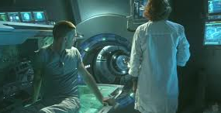
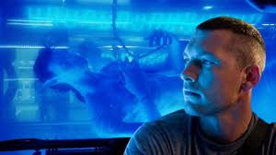
Philosophy of Mind: from the Perspective of Applied Engineering
http://www.thefreedictionary.com/embodiment
http://www.youtube.com/user/mindsignonline
EMBODIMENT
AVATAR ?
ROBOTICS
Embedded Chips
Integrated prosthetics
The question of how biological & physical processes
inter-relate with mental processes
ETHICS related to artificial intelligence and medical treatments
Notes:
relationship that exists between minds, or mental processes, and bodily states or processes

Slide 24
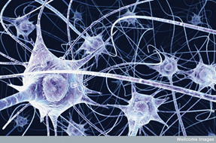
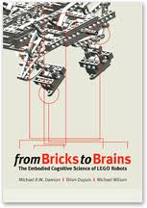
Embodied cognition
The body influences the mind
Senses
Stimuli
Perception
Environment
Emotions influence the mind
Cognition is part and parcel to the environment- the situation we’re in. Decoupled from that, cognition is a set of skills and abilities which include: perception and visualization of imagery, working memory, episodic memory, implicit memory and the ability to solve problems.
WOW! A robot with embodied cognition-

Slide 25
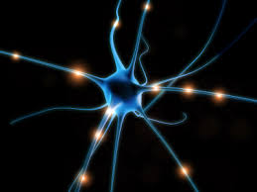
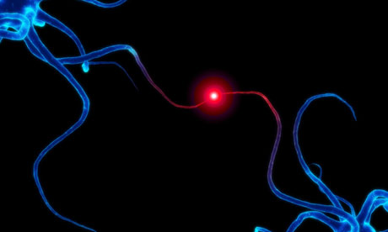
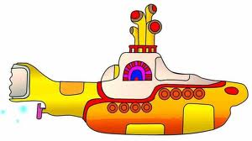
Philosophy of Mind: law of physics perspective: Is the brain connected to the universe at a quantum level?
Research in 2013 discovered quantum vibrations in neuron microtubules
microtubules are part of the cell scaffolding
protein polymers inside brain neurons
Both govern neuronal and synaptic function
& connect brain processes to self-organizing processes
Theory of Orchestrated Objective Reductions is highly contested
Notes:
The restatement of the theory has produced a flurry of criticism in the journal where it was published, Physics of Life Reviews, but the authors maintain that their theory suggests…
“…conscious experience is intrinsically connected to the fine-scale structure of space–time geometry, and that consciousness could be deeply related to the operation of the laws of the universe.”
Orchestrated objective reduction (Orch-OR) is a controversial 20-year-old theory of consciousness conceptualized by the theoretical physicist Sir Roger Penrose and anesthesiologist Stuart Hameroff, which claims that consciousness derives from deeper level, finer scale quantum activities inside the cells, most prevalent in the brain's neurons. It combines approaches from the radically different angles of molecular biology, neuroscience, quantum physics, pharmacology, philosophy, quantum information theory, and aspects of quantum gravity.^{[1]}

Slide 26
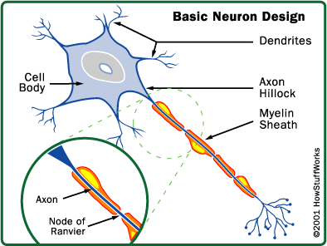
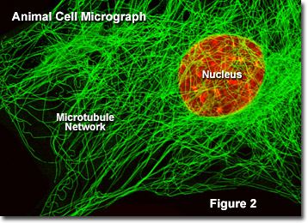
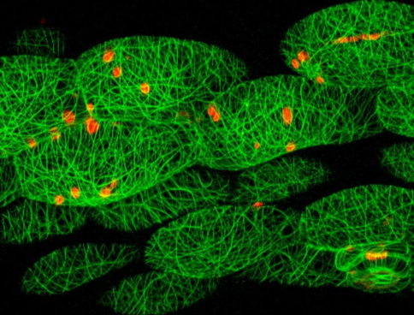
What is consciousness?
“Even the best computer doesn't know it exists.”
Agree?
nucleus
Axon terminal

Slide 27
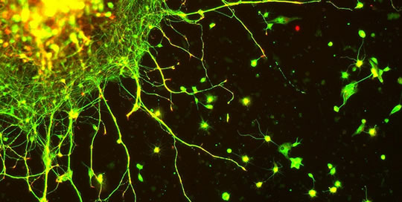
If consciousness is linked to the laws of the universe……
“…conscious experience is intrinsically connected to the fine-scale structure of space–time geometry, and that consciousness could be deeply related to the operation of the laws of the universe.”
Notes:
The restatement of the theory has produced a flurry of criticism in the journal where it was published, Physics of Life Reviews, but the authors maintain that their theory suggests…
“…conscious experience is intrinsically connected to the fine-scale structure of space–time geometry, and that consciousness could be deeply related to the operation of the laws of the universe.”

Slide 29
Make some notes, share with your neighbors:
What is mind? Does it have parts? Is mind
different from the brain?

Slide 30
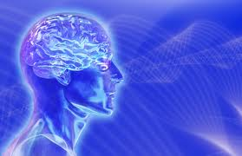
What is the Mind?
How does the mind relate to the brain, and body?
What is a mind like?
What are the properties or characteristics?
Do minds have parts?
If so, how would you describe them?
Is mind different from the brain?
Where does it start, where does it end?

Slide 31
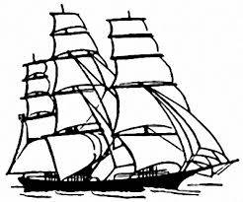
Pirates and Dualism

Slide 32
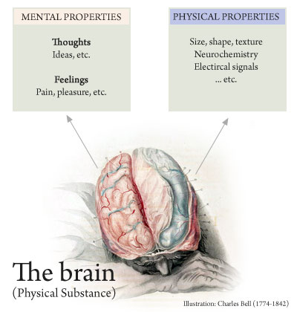
properties
Property is the attribute of something, or its quality
Questions:
If the quality is accidental is it still a property?
Does it have to be perceived to exist as a property?
Is the mind an intrinsic property, or is it extrinsic?
Examples??

Slide 33
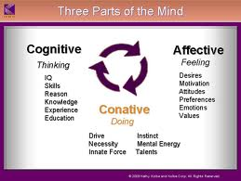
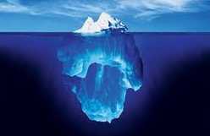
Does the mind have Parts ?
Conative
Cognitive
Affective
Implicit Memory
Explicit Memory

Slide 34
IS BEHAVIOR LEARNED? ETHICS, IDENTITY & LAW
Who is James Holmes?
Same Person?
Guilty, or not guilty by insanity?
Is he responsible for his actions? Why?
https://www.youtube.com/watch?v=O0kuM6vv6u4

Slide 35
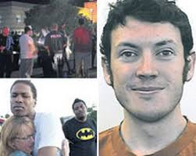
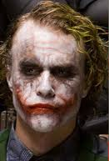
Ethics
Guilty, innocent or guilty by insanity?
He was diagnosed with Schizophrenia… is he responsible for his actions?

Slide 36
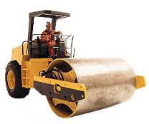
Mind Theory Identity Body Theory Identity
Meredith Michaels: Persons, Brains and Body
Wanda and You
If identity is memories in our brain
then Schwanda is Wanda
If identity is our senses and our bodies, then You are Schwanda

Slide 37
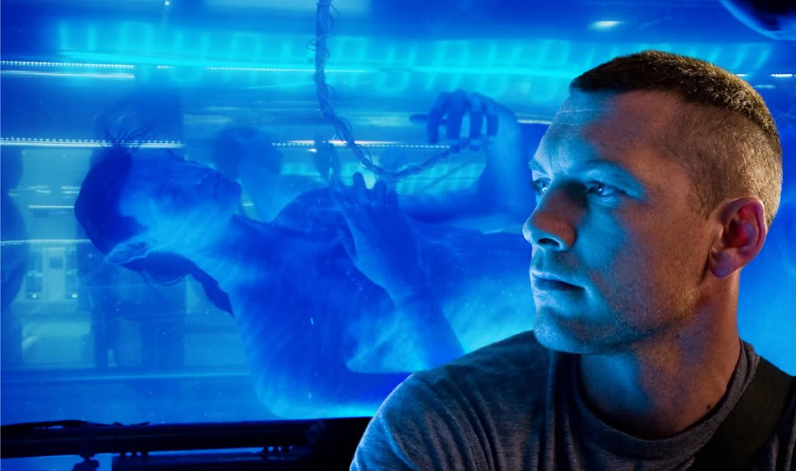
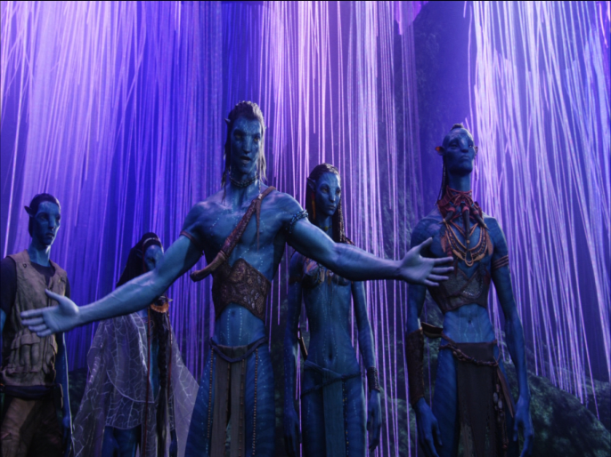
Who is the real Jake Sully?
Critical Thinking Questions:
is the mind part of the brain and body?
If they are distinct, how do they interact?
Does the answer change the way we learn, engineer robots or design tech? Should robots have the same rights as humans?
In what ways does this change or affect identity and the idea of who you are and how you got to be that way?
How vast is the mind?
Is there a collective mind?

Slide 38
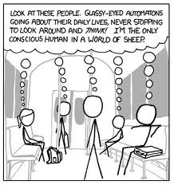
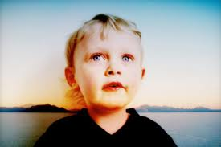
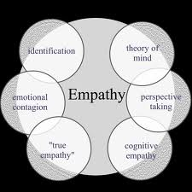
The Problem of Other Minds
http://www.youtube.com/user/mindsignonline
http://www.ted.com/talks/rebecca_saxe_how_brains_make_moral_judgments.html
Notes:
Theory of mind is a cognitive skill where children starting at age 4 begin to understand that people can be motivated by beliefs regardless of whether those beliefs are true or false. Using more mentalistic language helps children develop a theory of mind because of pragmatic features of the language, such as the enunciation of various perspectives (Harris,de Rosenay, & Pons, 2005). Using terms like think and know can help in development of theory of mind because when children themselves attribute false beliefs to others, they end up using similar linguistic constructions.
When mothers talk to their children about how others can have false beliefs, they also end up expressing various emotions that come by the virtue of having those beliefs (Harris, de Rosenay, & Pons, 2005). This is why use of mental terms in language not only helps in understanding of false beliefs but also understanding of how people can be affected by these false beliefs.

Slide 39
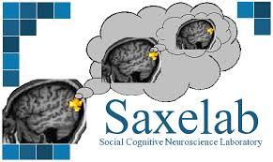
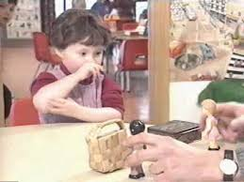
Theory of Mind
Rebecca Saxe: http://www.ted.com/talks/rebecca_saxe_how_brains_make_moral_judgments.html

Slide 40
Any thoughts about Wanda?

Slide 41
For more information | class one:
Dr. Gazziniga: Split brain research
http://www.informationphilosopher.com/solutions/scientists/gazzaniga/
Dr. Gazzinga and Alan Alda -Brains work independently
https://www.youtube.com/watch?v=lfGwsAdS9Dc
The Interpreter Within: The Glue of Conscious Experience
http://www.dana.org/Cerebrum/Default.aspx?id=39343
Dr. Ganziga, split-brain research
http://www.nytimes.com/2011/11/01/science/telling-the-story-of-the-brains-cacophony-of-competing-voices.html?pagewanted=all
Video: http://www.nytimes.com/video/science/100000001142409/michael-gazzaniga.html
http://bigthink.com/users/michaelgazzaniga
Legal Responsibility
Center for Law, Brain and Behavior http://clbb.mgh.harvard.edu/criminal-responsibility/
James Holmes video as a teenager, as an adult killer:
https://www.youtube.com/watch?v=RKB0Oene5Ys
Coma Patients: http://www.medpagetoday.com/Neurology/HeadTrauma/40947
See Monkey, See monkey Do: Mirror Neuron Research
http://www.psychologicalscience.org/index.php/news/releases/monkey-see-monkey-do-the-role-of-mirror-neurons-in-human-behavior.html
See Monkey, See Monkey Do
http://www.pbs.org/wgbh/nova/education/body/mirror-neurons.html
Mirror Neurons and Intention
http://www.youtube.com/watch?v=Tq1-ZxV9Dc4

Slide 42
Things we say…
Frame of mind
Mind over matter
State of mind
Out of your mind
Are you in your right mind?
Mindless
Beside yourself
Pull yourself together

